Slide 1

Online health status detection of a motor
MAS513-Advanced Robotics project:
PROBLEM: Is it possible to determine the health status of the motor continuously using non-contact sensors and non-destructive testing?
Gianluca Salata, 25/08/2021

Slide 2


State of art:
KEY CONCEPT: Each fault is related to a precise harmonic in the spectrum
1) MCSA(motor current signature analysis)
2) Vibration analysis
This method require to measure the variation of the absorbed current from the motor.
From the current spectra is able to identify motor’s fault thanks to a specific relationship.
For example, the frequency related to an air gap(eccentricity):
Usually It is based on 3-axis MEMS accelerometers that measure the vibration of the shaft. Also in this case is possible to find fault analysing the spectrum of the displacement of the shaft.
An outer race bearing defect is related a to the characteristic frequency:
$$f_{\text{ecc}}=\left\{\left(R±n_{d}\right)\left(\frac{1−s}{p}\right)±n_{ωs}\right\}f_{0}$$
Gianluca Salata, 08/09/2021

Slide 3
State of art:
MCSA | Vibration analysis | Vibration analysis with Lidar
non-invasive | independent of the type of motor power supply | independent of the type of motor power supply
Easy to implement | low power consumption | High reliability
low signal-to-noise ratio | Low realiability | Non contact-sencors
contact-sensors | contact-sensors | High cost
Gianluca Salata, 08/09/2021
Notes:
Figure 7(a) it is possible to notice that the fault-related frequencies have low amplitude in comparison with all of the others spectra, especially the gearbox frequencies. In the presence of the bearing fault when the gear is in a good condition as Figure 7(b) shows, the amplitudes of the frequencies remain on the same approximated level. However, the appearance of frequency components in both spectra is inevitable in the closest region to the mesh frequency sidebands and its harmonics.
ball pass outer race frequency ( Hz),

Slide 4
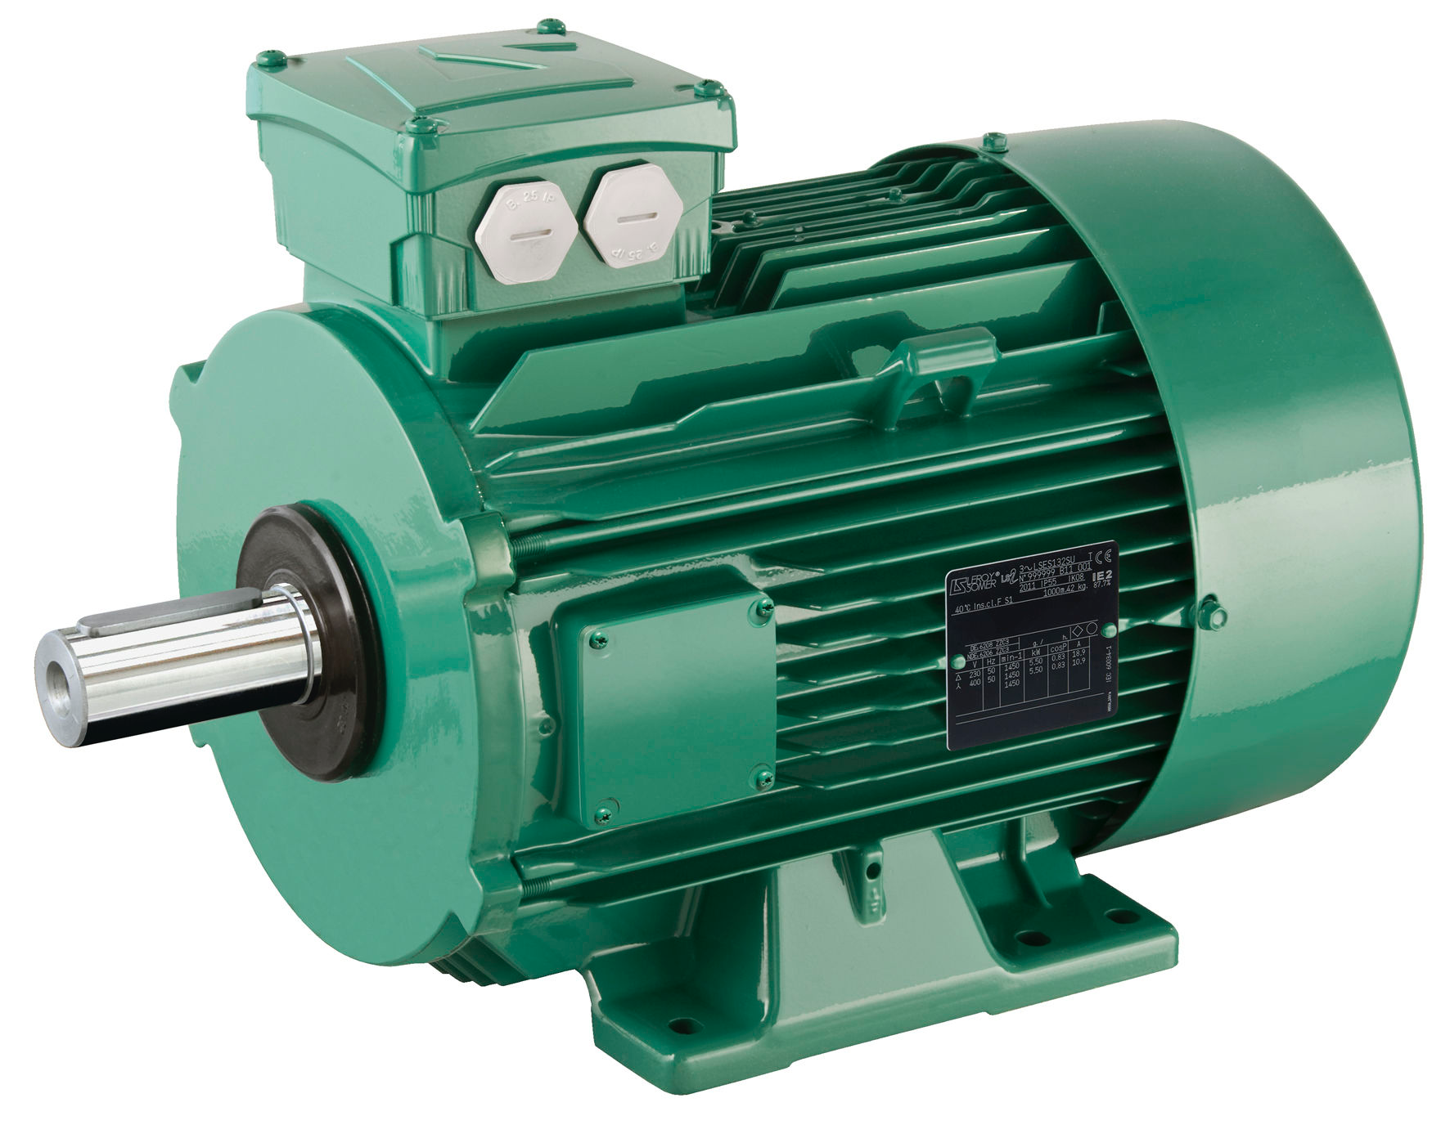
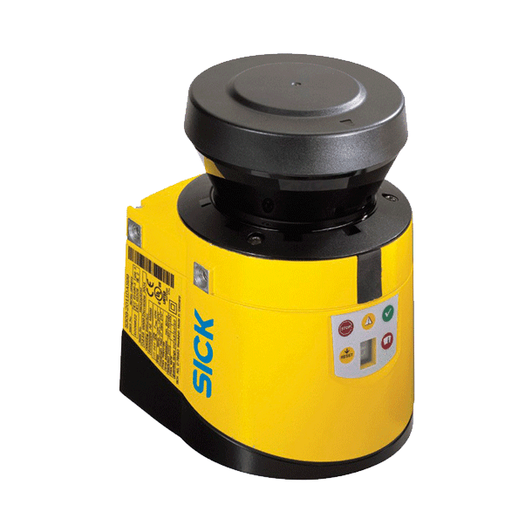
Project’s aim
The aim is to determine the continous health status of the motor developing the vibration analysis with a Lidar
The project want to define how to connect a Lidar and how to acquire data that fits properly the vibration analysis.
Makeover of the sensing part of the most used technique
Assumptions:
Only one fault can occur for each run (NO multiple-fault diagnosis)
Only air between the Lidar and the target
Consider only one direction vibration
PC
vibration analysis
Fault …
Gianluca Salata, 08/09/2021

Slide 5
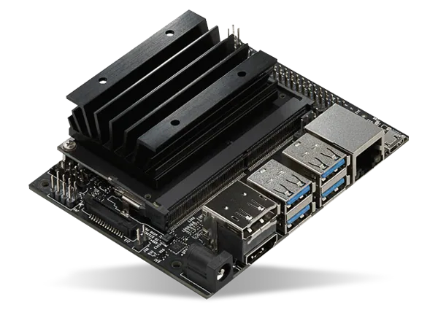


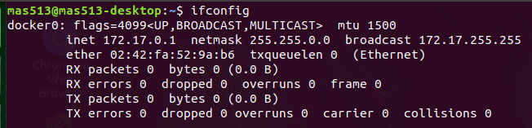
What already done:
Set the comunication between the board and the Lidar
Jetson nano →Ubuntu desktop 18.04 + ROS melodic
Set Lidar’s ip →Using SOPAS Engineering Tool
Set board ip
Installed Sick’s ROS node
Ethernet cable
Solved Problems:
Set two different IP of the device and the board but with the same subnet mask
Remove safety interface docker0 (only with this lidar)
Use development branch from github repository
Gianluca Salata, 08/09/2021
Notes:
Immagine della docker interface

Slide 6
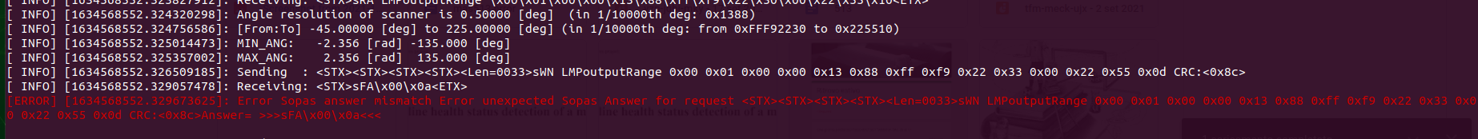
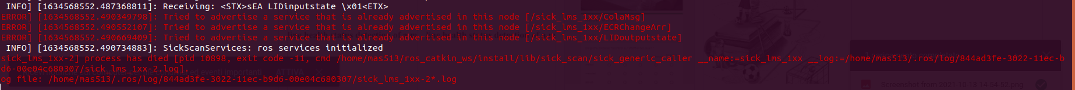
Actual problem:
Error in the comunication between ROS node and Lidar
…
Possible solution: Restore factory settings of the Lidar and changing parameters in the launch file
Gianluca Salata, 08/09/2021
Notes:
Immagine degli errori e immagine dei parametri all’inizio

Slide 7
What to do:
Set the communication between ROS and the lidar.
Set the Lidar in order to acquire depth of only 1 point.
Process the data (converting from binary to decimal,filtering, FFT).
Solve previous problem and setting a reasonable comunication frequency.
Modify ROS node parameters and filtering the point.
Create a ROS node with manufatcurer’s code for translation and python code base on scipy.fft for FFT.
HOW
Gianluca Salata, 08/09/2021

Slide 8
Thanks for the attention!
Gianluca Salata, 08/09/2021

